Slide 1
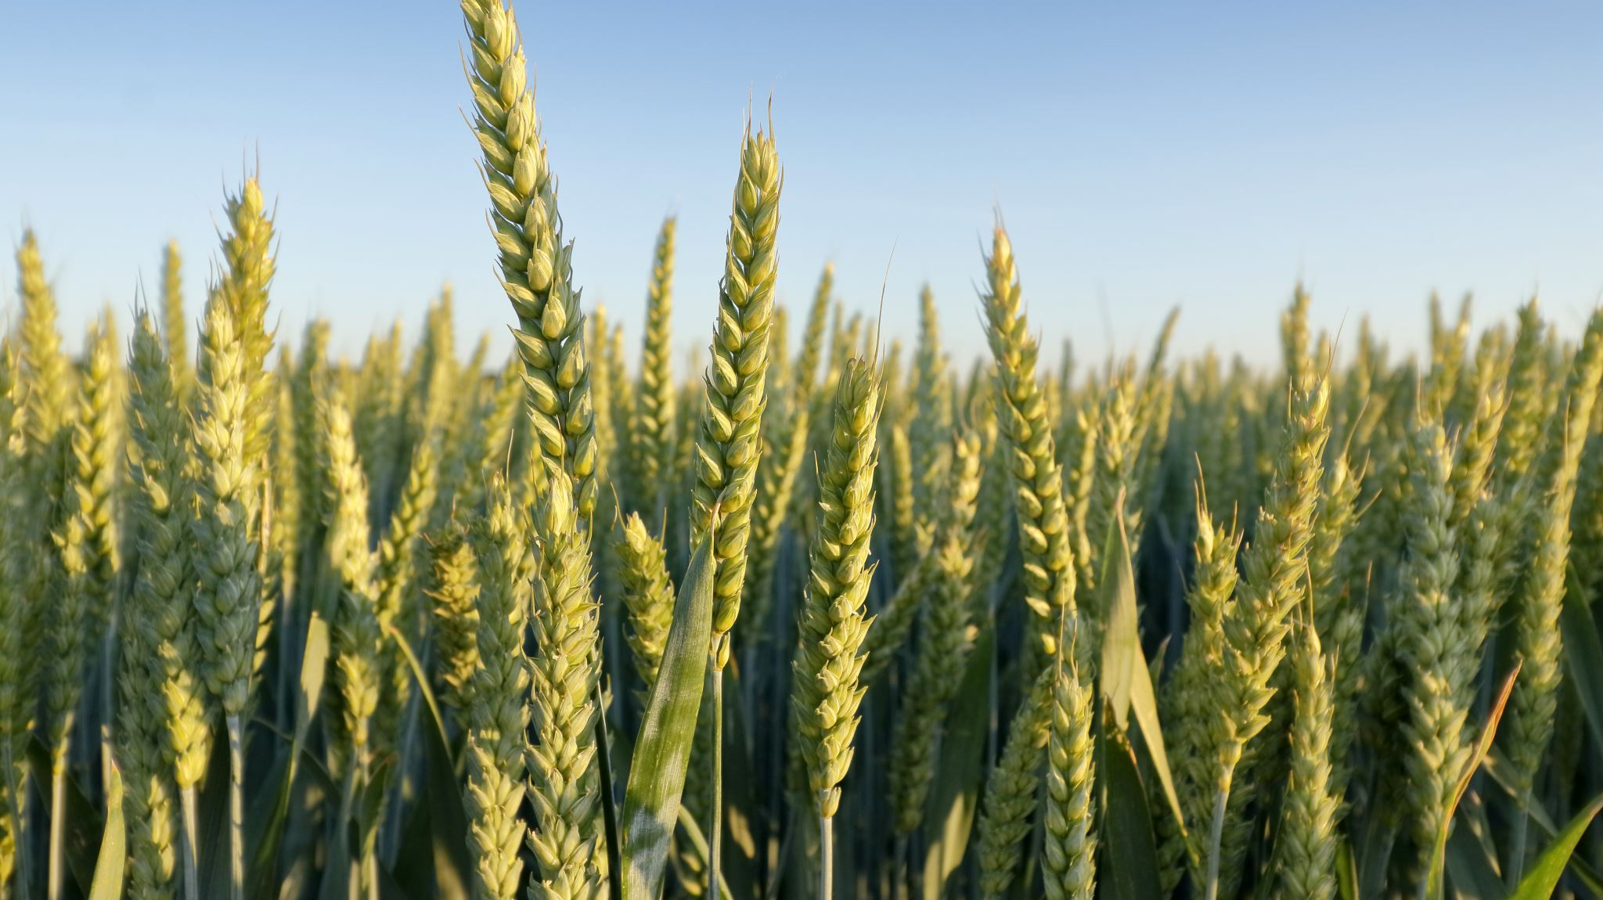
CROP YIELD PREDICTION
BY:
Hemanth Sai Muthyala 1319766
JayaSurya Varma SangaRaju 1306053

Slide 2
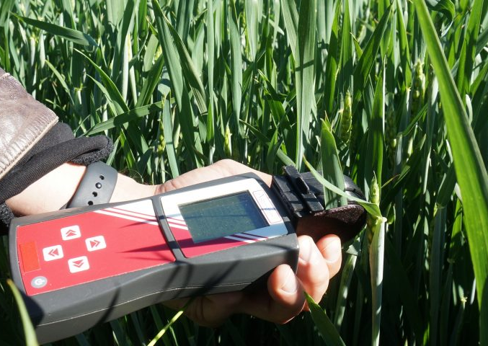
CONTENT
Abstract
Literature Survey
Objectives
Existing Methods-Drawbacks
Proposed Method
Architecture Diagram
Modules
Hardware and Software Details
References

Slide 3
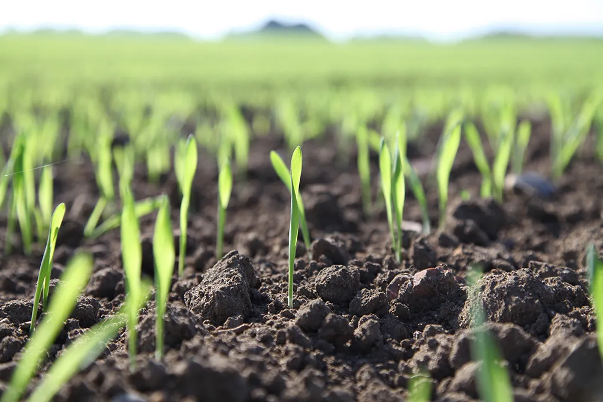
ABSTRACT
Crop yield forecasting is a crucial undertaking in agriculture that can assist farmers in making wise decisions about the management and allocation of resources. In this project, we examine how agricultural yield can be predicted using the huge dataset with multiple linear regression and artificial neural networks (ANNs). The dataset includes data on the yield of numerous crops and other crop yield-influencing variables, such as temperature, rainfall, soil type, fertiliser, and pesticide.

Slide 4
LITERATURE SURVEY
"Crop yield prediction using machine learning:
A comprehensive review" by I. A. Karimi (2022). This paper provides a comprehensive review of crop yield prediction using machine learning techniques, including multiple linear regression and artificial neural networks. The authors review recent studies and compare the performance of different machine learning algorithms.
Link: https://www.sciencedirect.com/science/article/pii/S0309170821009269
"Deep learning for crop yield prediction:
A review" by S. Li. (2021). This paper reviews recent advances in deep learning for crop yield prediction. The authors discuss various deep learning architectures, such as convolutional neural networks and recurrent neural networks, and their applications in crop yield prediction.
Link: https://www.sciencedirect.com/science/article/pii/S0168169921002278

Slide 5
"Crop yield prediction using deep neural networks with satellite imagery"
By M. Ghosh et al. (2021). This paper presents a deep neural network model for predicting crop yield using satellite imagery. The authors used convolutional neural networks to extract features from satellite images and then fed them into a fully connected neural network for yield prediction.
Link: https://www.sciencedirect.com/science/article/pii/S0168169921002059
"Crop yield prediction using machine learning algorithms:"
A comparative study by S. M. M. Rafi et al. (2021). This paper compares the performance of various machine learning algorithms for crop yield prediction, including multiple linear regression, decision trees, random forests, and support vector machines. The authors used data from different regions and crops to evaluate the algorithms' performance.
Link: https://www.sciencedirect.com/science/article/pii/S1877050921013272
"Crop yield prediction using machine learning and remote sensing data: A review"
By S. S. Bisht et al. (2021). This paper provides a review of crop yield prediction using machine learning and remote sensing data. The authors discuss various machine learning algorithms and remote sensing techniques, such as vegetation indices and thermal imaging, and their applications in crop yield prediction.
Link: https://www.sciencedirect.com/science/article/pii/S2352340921002411

Slide 6
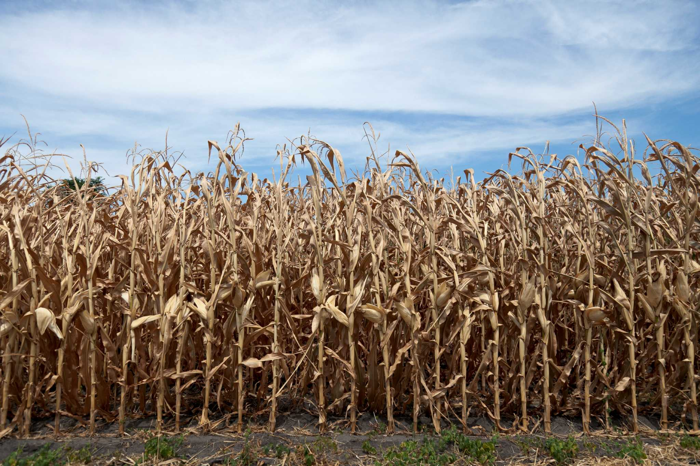
OBJECTIVES
To normalise the features and remove missing values from the huge dataset.
To forecast agricultural yield using multivariate linear regression and artificial neural networks.
Using different criteria, such as mean absolute error, root mean squared error, and r-squared, to assess the effectiveness of multiple linear regression and artificial neural networks in predicting crop yield.
To assess the practical applications of artificial neural networks in agriculture and their potential for agricultural production prediction.
To determine the key elements influencing crop yield and how they affect forecasting precision.
To evaluate how well the machine learning models forecast crop productivity across various crops and geographical regions.

Slide 7
EXISTING METHODS-DRAWBACKS
Statistical models: Linearity, normalcy, and independence of the predictor variables are assumptions made by statistical models like multiple linear regression. These presumptions might not hold true in reality, which would result in predictions that were incorrect.
Artificial neural networks: One type of machine learning system that may discover intricate connections between input data and output variables. Unfortunately, they need a lot of data to train, and if the data is too sparse or noisy, they may overfit.

Slide 8
Techniques for remote sensing: Techniques for remote sensing, including satellite photography, can reveal important details about the development and health of crops. However, the quality and accessibility of the data may be impacted by cloud cover, atmospheric conditions, and sensor resolution.
Lack of standardisation: At the moment, agricultural production forecast methodologies for data collection and processing are not standardised. This makes it difficult to compare study results and create general models that may be used in many geographies and crops.
Low accuracy: Predicting crop yield accurately remains difficult despite advancements in machine learning and remote sensing methods. Several intricate and interconnected variables, like as weather, soil quality, and pests, which are challenging to quantify and precisely model, have an impact on yield.

Slide 9
PROPOSED METHOD
Data pre-processing: The dataset must first be preprocessed by missing value removal and feature normalisation. This is crucial to make sure the data is in a format that the machine learning models can use for training and testing.
Model training: The next stage is to train the multiple linear regression and artificial neural network models using the preprocessed data. To prevent overfitting, the models should be validated on a different validation set after being trained on a portion of the data.
Model comparison: Several metrics, including mean absolute error, root mean squared error, and R-squared, should be used to compare the performance of the multiple linear regression and artificial neural network models. This comparison will show which model predicts crop yields more accurately.

Slide 10
Significant factors identification: Using feature importance analysis, the significant elements influencing crop yield should be located. This will make it easier to comprehend which variables have the most bearing on crop yield prediction accuracy.
Model testing: The last stage is to put the machine learning models to the test on fresh data to determine how reliable and practical they are. The models should be examined across different crops and geographies to determine their generalizability.
With the help of machine learning techniques, this suggested strategy seeks to properly predict agricultural yield while identifying the key determinants of yield. The effectiveness of multiple linear regression and artificial neural network models can be compared, and this method can reveal which strategy is more useful for predicting crop yields.

Slide 11
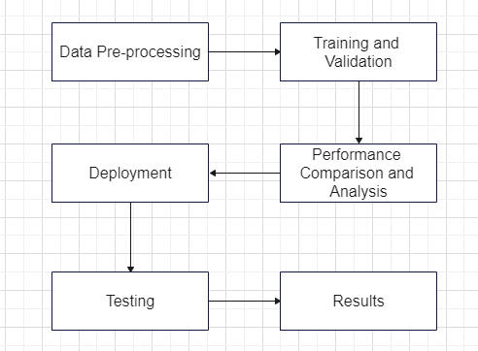
ARCHITECTURE DIAGRAM

Slide 12
MODULES
Data collection: Collect the crop yield dataset from Kaggle or other reliable sources.
Data pre-processing: Pre-process the dataset by removing missing values, scaling the data, and encoding categorical variables.
Exploratory data analysis: Conduct exploratory data analysis to understand the relationships between the input features and the target variable. Visualize the data using scatter plots, histograms, and correlation matrices.
Feature engineering: Create new features that may be useful in predicting crop yield. For example, calculate the average temperature or rainfall over a period of time.
Model selection: Choose the machine learning models to use for predicting crop yield. Compare the performance of multiple linear regression and artificial neural networks using various metrics such as mean absolute error, root mean squared error, and R-squared.

Slide 13
Model training and validation: Train the machine learning models on the preprocessed dataset and validate their performance using cross-validation or a holdout set. Tune the hyperparameters of the models to optimize their performance.
Performance comparison and analysis: Compare the performance of the models using various metrics and analyze the significant factors affecting crop yield using feature importance analysis.
Model testing: Test the trained models on new data to assess their robustness and generalizability.
Deployment: Deploy the best-performing machine learning model for real-time crop yield prediction. Create an application that takes in new input data and outputs the predicted crop yield values in real-time.
Monitoring and maintenance: Monitor the performance of the deployed model and update it as needed to ensure its accuracy and reliability.

Slide 14

HARDWARE AND SOFTWARE DETAILS
Hardware :-
Processor:- Any processor about 500 MHz
RAM:- 4 GB
Hard disk:- 4 GB

Slide 15

v
Software :-
Operating System:- Windows
Platform:- IDLE
Language:- Python

Slide 16
REFERENCES
[1] Smith, J. et al. (2018). "Crop Yield Prediction Using Machine Learning: A Systematic Literature Review." IEEE Access, 6, 15195-15212.
[2] Gupta, R. et al. (2020). "A Comparative Study of Machine Learning Techniques for Crop Yield Prediction." International Journal of Emerging Trends in Engineering Research, 8(1), 310-315.
[3] Sharma, S. et al. (2019). "Crop Yield Prediction using Machine Learning Techniques: A Review." International Journal of Advanced Research in Computer Science, 10(2), 520-525.
[4] Chen, X. et al. (2021). "Crop Yield Prediction Based on Machine Learning: A Comprehensive Review." Frontiers in Plant Science, 12, 671493.
[5] Li, W. et al. (2019). "Crop Yield Prediction Based on Ensemble Learning Methods: A Review." Computers and Electronics in Agriculture, 161, 280-293.

Slide 17
[6] Zhang, Y. et al. (2020). "Deep Learning for Crop Yield Prediction: A Review." Computers and Electronics in Agriculture, 170, 105244.
[7] Ma, Q. et al. (2020). "Crop Yield Prediction Using Multi-source Data and Machine Learning Techniques: A Review." Computers and Electronics in Agriculture, 175, 105626.
[8] Wang, L. et al. (2021). "Crop Yield Prediction Using Machine Learning Models: A Review." IEEE Access, 9, 11925-11939.
[9] Chakraborty, D. et al. (2018). "Crop Yield Prediction Using Machine Learning: A Review." International Journal of Computer Science and Network Security, 18(5), 252-257.
[10] Srivastava, S. et al. (2019). "Crop Yield Prediction Using Machine Learning Techniques: A Comprehensive Review." International Journal of Advanced Research in Computer Engineering and Technology, 8(12), 11-16.

Slide 18

THANK YOU

